Slide 1
Uber Airport Supply-Demand Gap
Sri Harsha Ravi
02-Dec-2018

Slide 2
Contents
Problem
Analysis
Recommendations

Slide 3
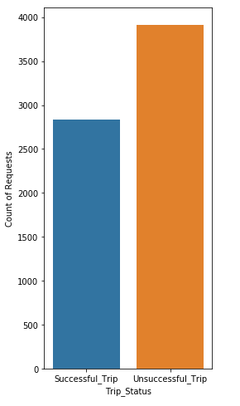
Problem
58 % of the requests to and from the ‘Airport’ are not getting Served either due to ‘No Cars Available’ or due to Driver ‘Cancellations’

Slide 4
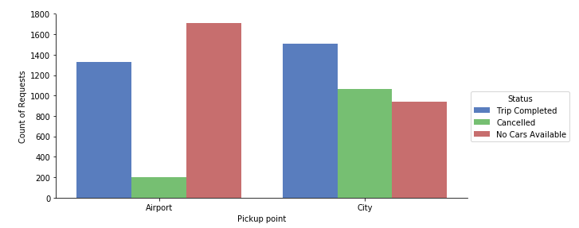
Analysis
High number of drivers ‘Cancelled’ the Airport Trips from City and High percentage of ‘No Cars Available’ at
Airport

Slide 5
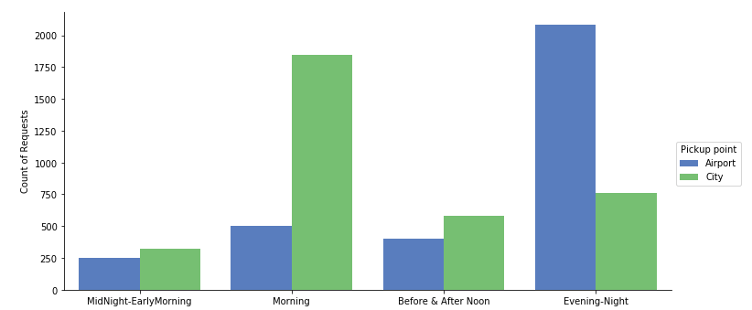
Analysis
High number of requests coming in from Airport during Evening-Night (5pm – 11pm) and
good number of requests from City during Morning (5 am – 10 am)

Slide 6
Analysis
Pickup Point Airport -> High Demand during Evening-Night (5 pm – 11pm), many flights arrive in the Evening-Night and majority of them are not served due to ‘No Cars Available’ as Drivers do not want to travel empty from City to Airport/Busy making trips inside City
Pickup Point City -> High Supply gap during Morning (5 am – 10 am) as majority of them are not served due to ‘Cancelled’ as Drivers do not want to travel back empty from Airport as idle time at Airports could be high as not many Flights arrive in the Morning Slot

Slide 7
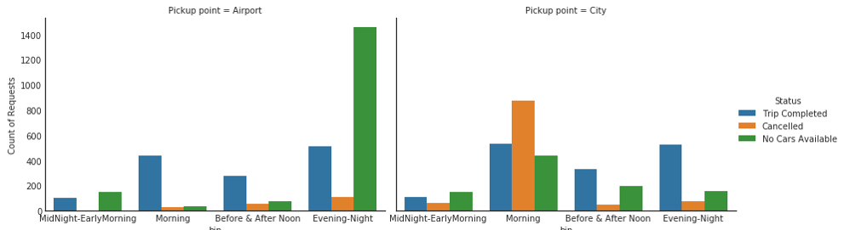
Graph justifying the slide 6

Slide 8
Recommendations
As ‘No Cars Available’ at Airport from 5pm – 11pm seems to be biggest issue, Uber needs to encourage the drivers to travel to Airport maybe from 4pm in the evening by offering the drivers higher incentives/increasing the value of the Trip
Uber also needs to do the same for the Drivers accepting the Airport Trips from City and also look at the ways to attract the drivers to register to Uber as the Cars Available at the City during the Morning time 5am – 10 am is an issue on top of majority of the Drivers cancelling the Airport Trips

